Slide 1

From Chicago to Springfield: Understanding Crime Rates and Policing Costs in Illinois Cities
BY:
Amanda Baynard, Andrew Voortman, Corbin Moore, Sania Sufi & Shunjia Liu

Slide 2
OUR HYPOTHESIS’
Hypothesis:
Null Hypothesis:
There exists a significant correlation between the allocated budget for city police departments and the overall crime rate in various municipalities across Illinois.
There is no significant correlation between the allocated budget for city police departments and the overall crime rate in various municipalities across Illinois.

Slide 3
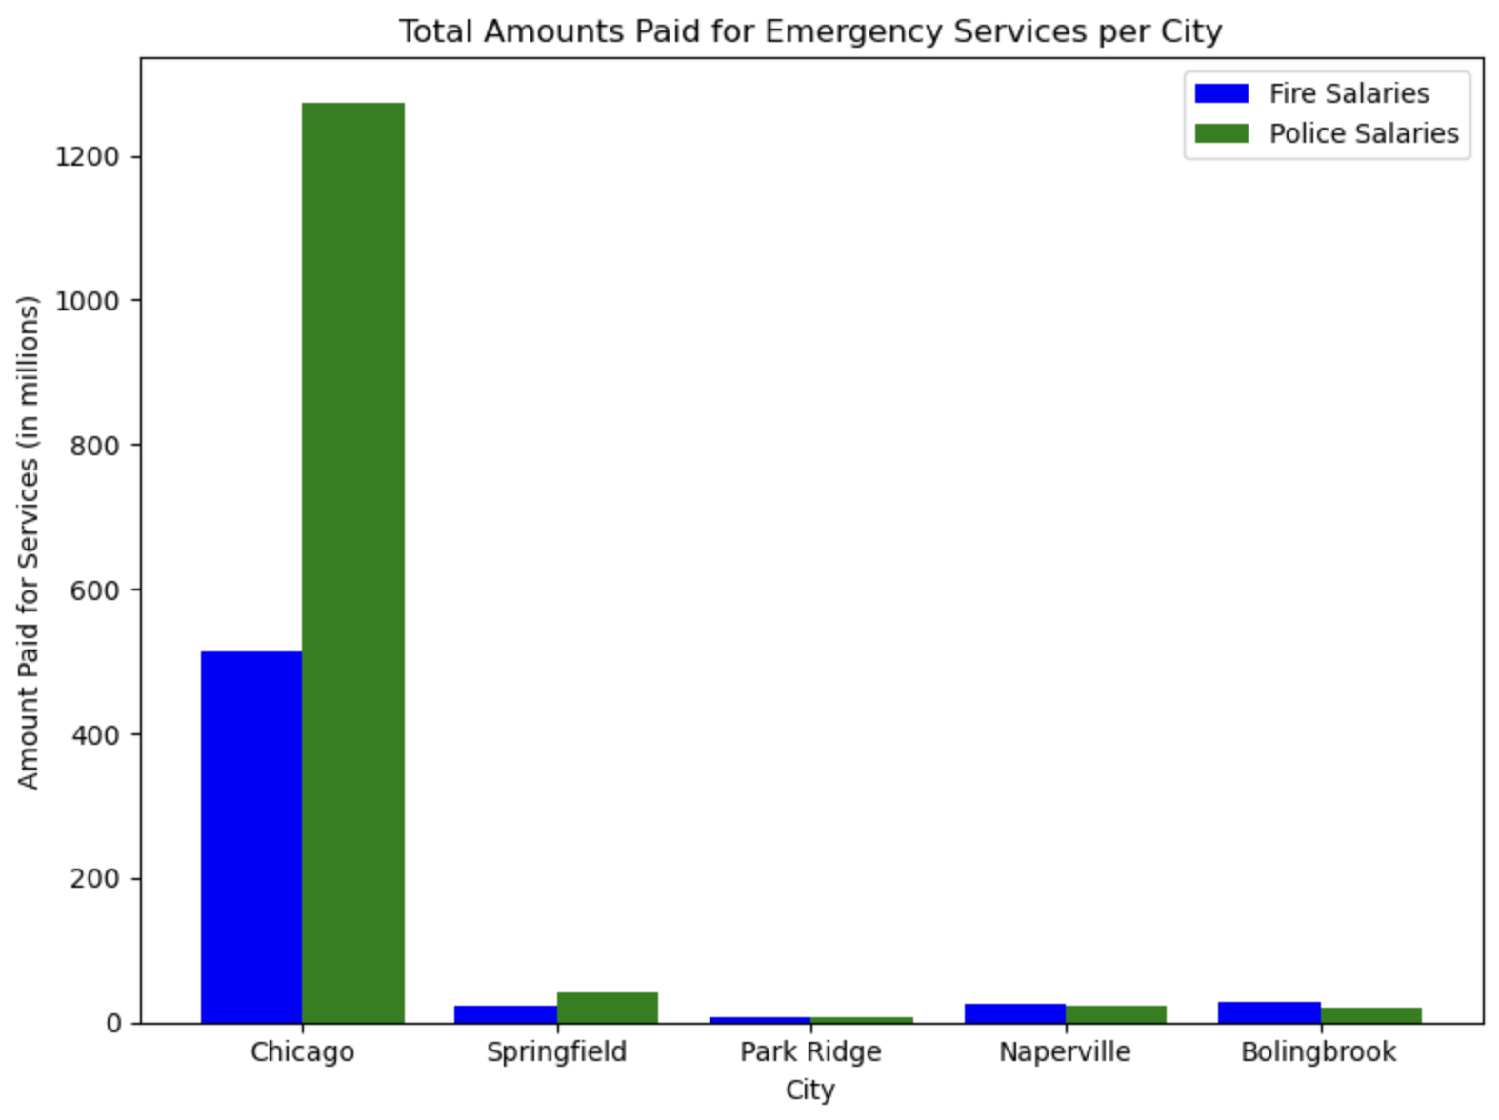
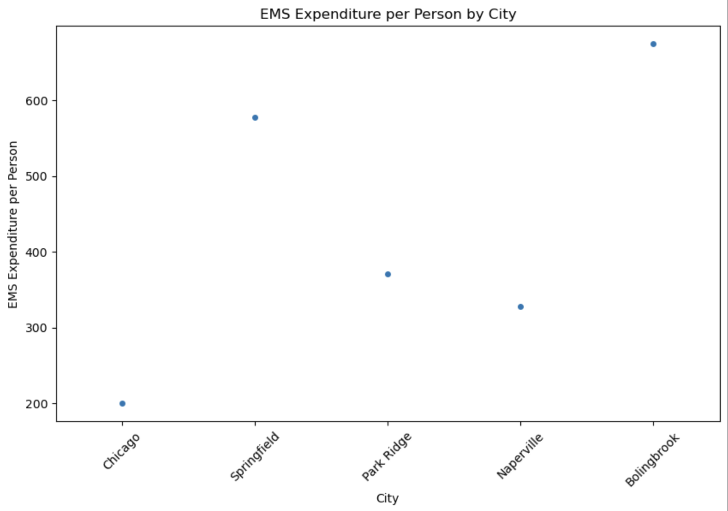
Emergency Services per City

Slide 4
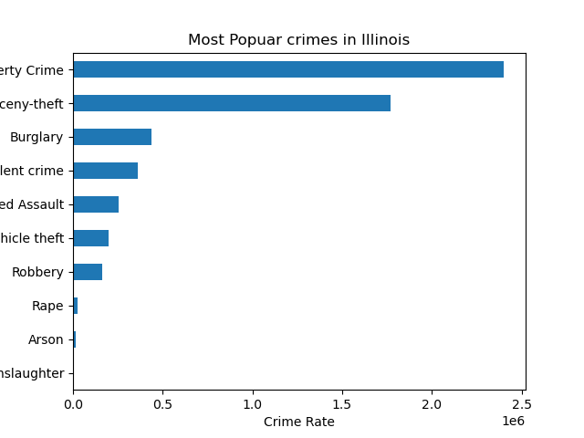
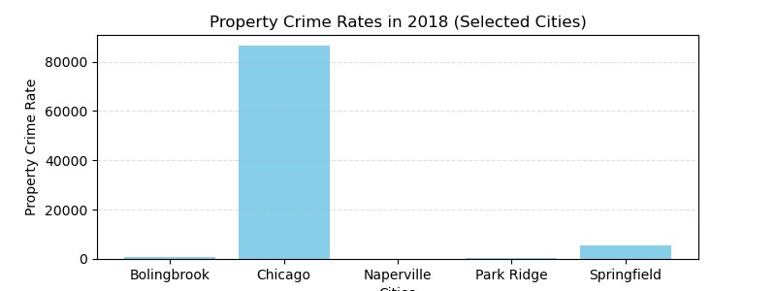
Most Popular Crimes in Illinois

Slide 5
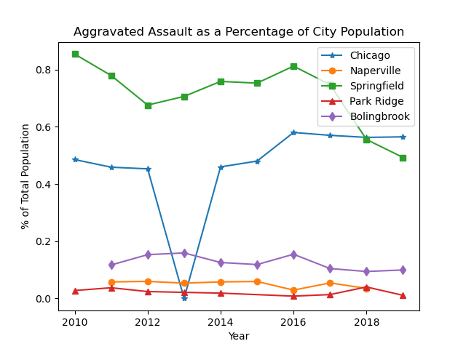
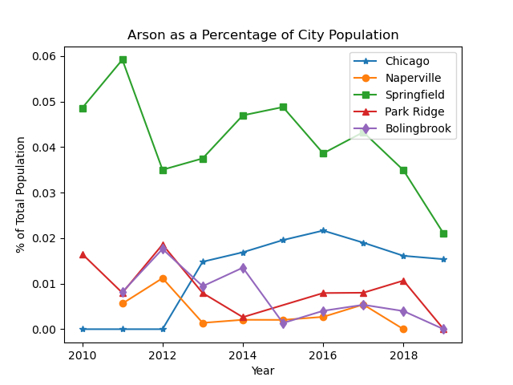
Breaking it down…

Slide 6
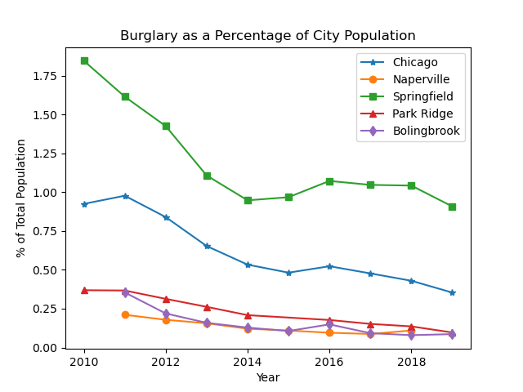
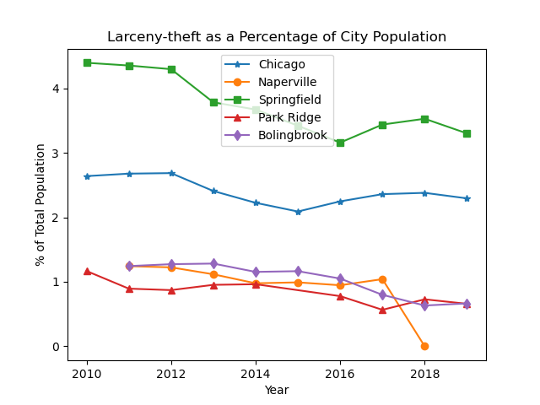

Slide 7
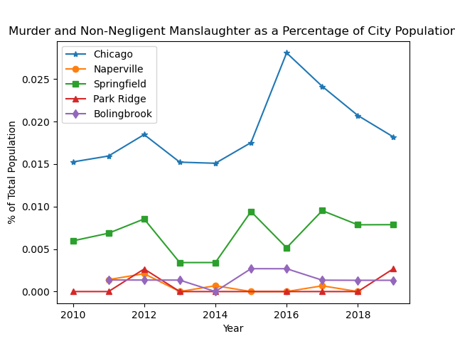
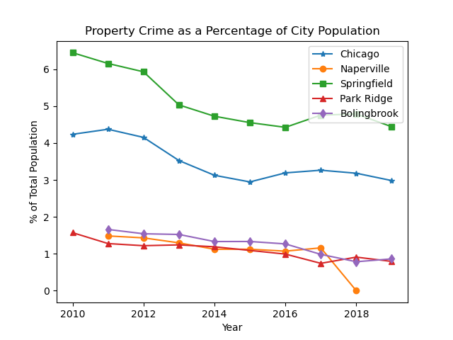

Slide 8
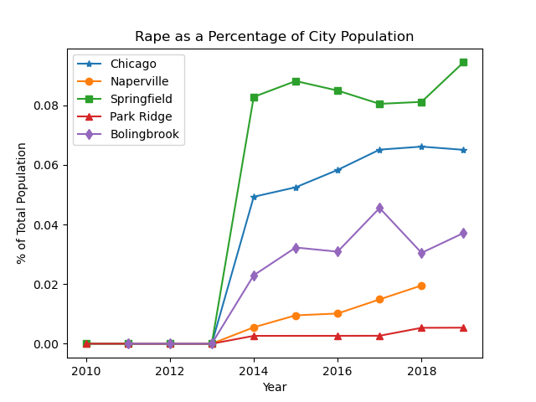
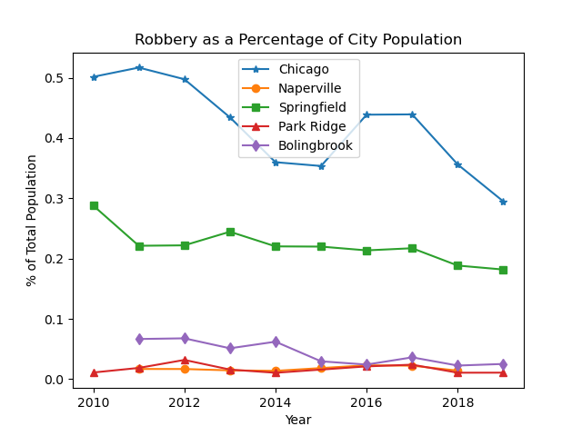

Slide 9
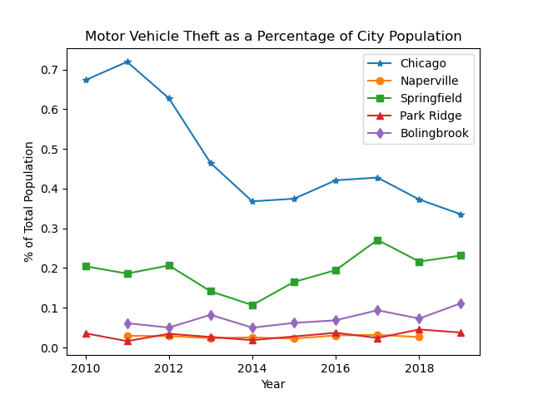
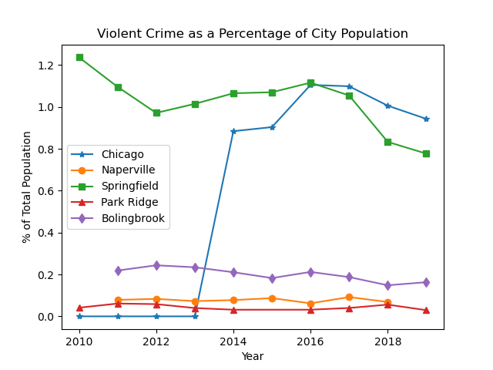

Slide 10
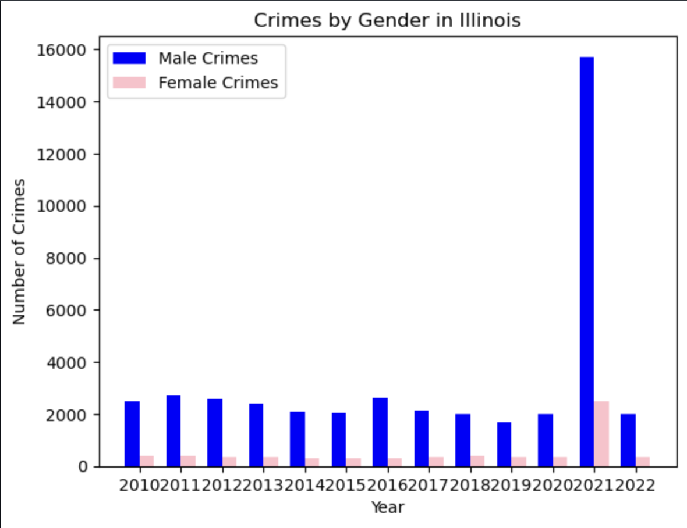
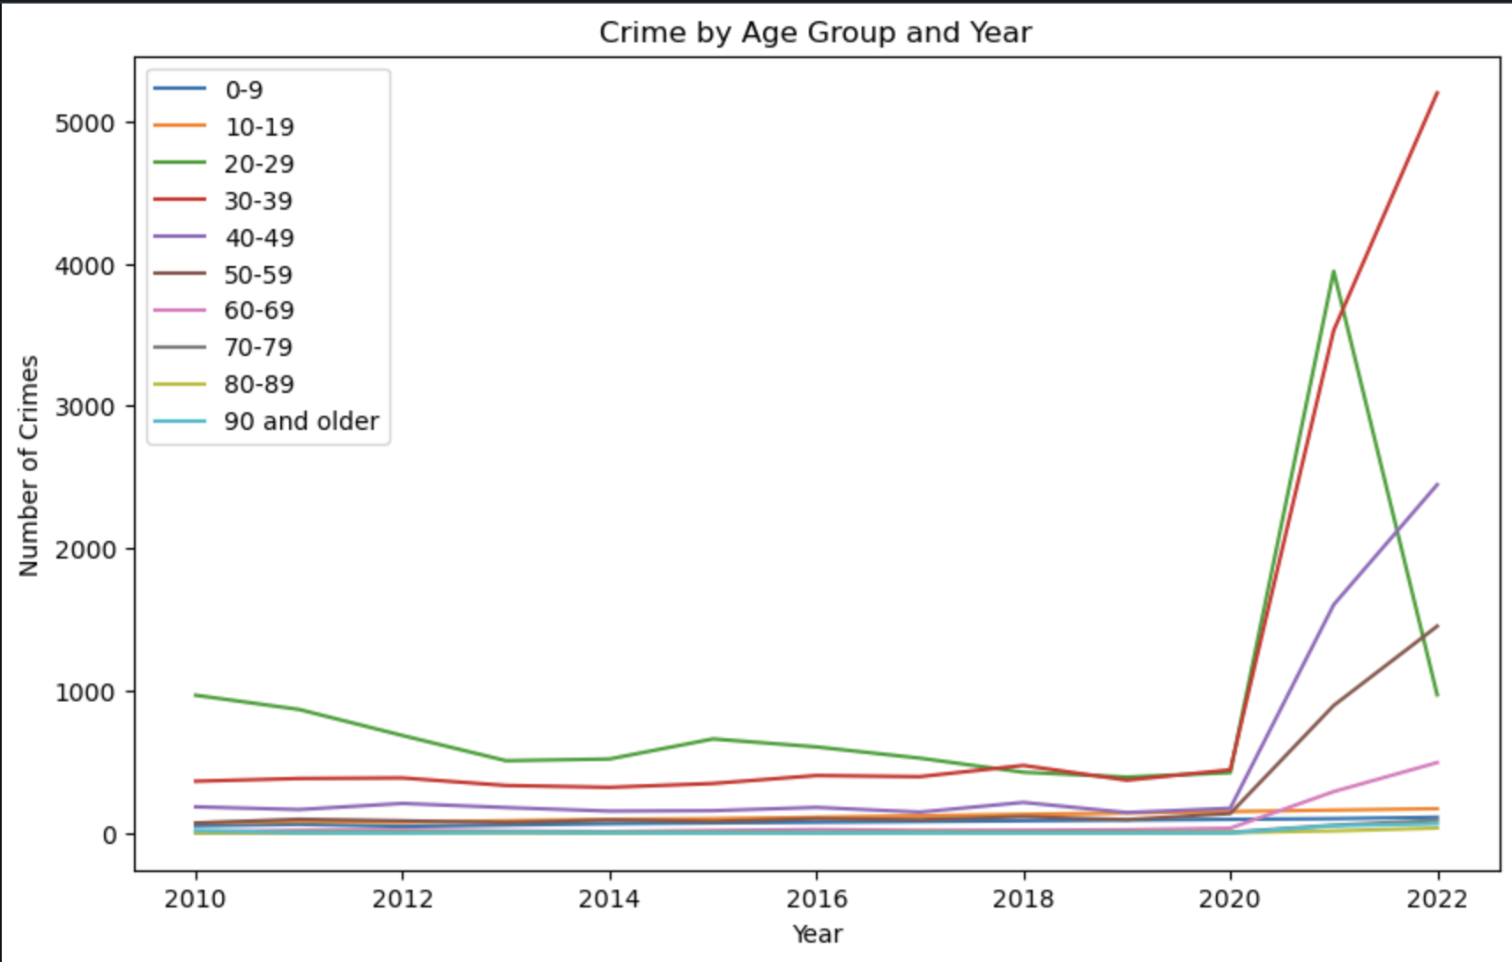
Crime by Gender and Age Group

Slide 11
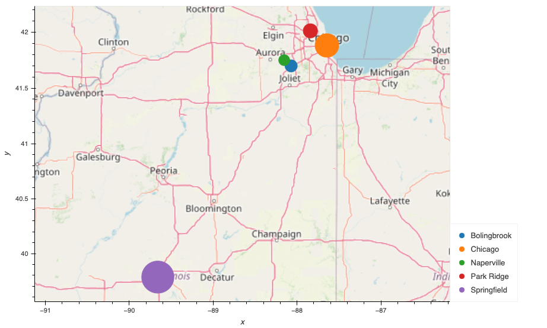
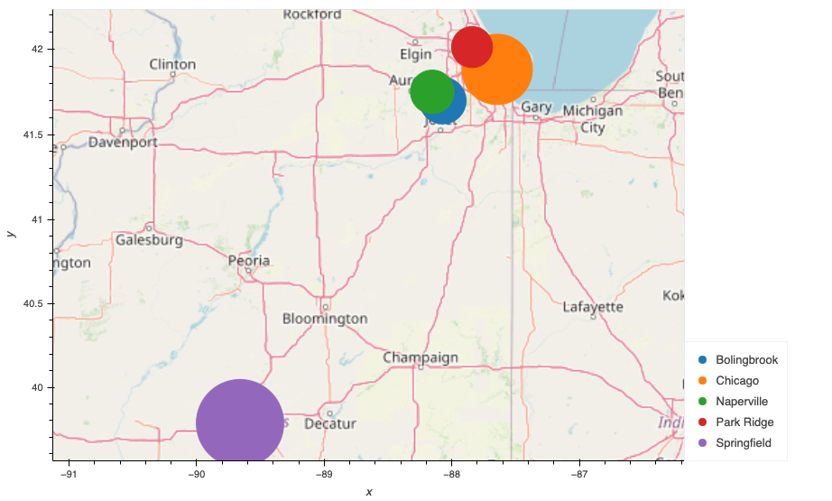
Crime rates per city
Larceny Theft
Burglary
Springfield
Bolingbrook
Park Ridge
Springfield
Park Ridge
Naperville
Chicago
Naperville
Chicago
Bolingbrook

Slide 12
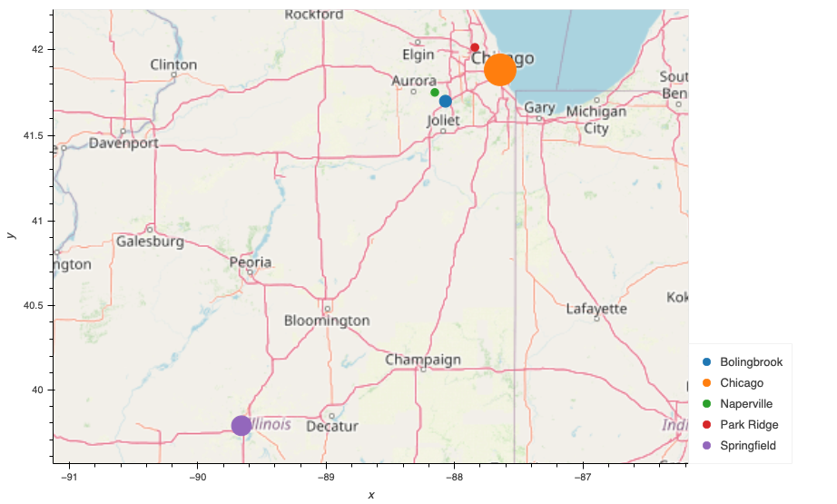

Motor Vehicle Theft
Robbery
Springfield
Bolingbrook
Park Ridge
Springfield
Bolingbrook
Park Ridge
Chicago
Naperville
Chicago
Naperville

Slide 13

Rape
Crime Rate Rank
No.1
Robbery Motor-Vehicle-Theft
No.2
Rape Larceny-theft Burglary
Chicago
No.1
Burglary
No.3
Rape Larceny-theft Robbery Motor-Vehicle-Theft
Bolingbrook
No.1
Rape Larceny-theft Burglary
No.2
Robbery Motor-Vehicle-Theft
Springfield
No.3
Burglary
No.4
Robbery Motor-Vehicle-Theft
Park Ridge
No.5
Rape Larceny-theft
No.4
Rape Larceny-theft
No.5
Burglary Robbery Motor-Vehicle-Theft
Springfield
Chicago
Bolingbrook
Naperville
Park Ridge
Naperville

Slide 14
Conclusion…
We concluded that

